Slide 1
NextGen Expense Reimbursement
(Concur)

Slide 2
Table of Contents
NextGen Expense Reimbursement (Concur) Introduction
NextGen Expense (Concur) Documentation
ieee.org/expense
Logging into NextGen is easy as 1-2-3
Concur Sample Enrollment Emails
Mobile App – Access Anytime, Anywhere
Expense Report Life Cycle
Concur & Western Union Payment Processing
Payment Currencies Support by Concur
Report Submitter Responsibilities
Concur User Profile
Report Submitter Self Service Features
Delegates
Approver Responsibilities
Approvers – View all Expense Reports You’ve Approved
Helpful Tips
My NextGen Experience Dashboard
Currency Exchange Fee
Receipt Date = Transaction Date
Expense Entry Line
Expense Report Purpose Levels
Self Service – NextGen Help Menu’s
Report Library
What's the Status of my Report
Move Command
Audit Trial
Missing Receipt Declaration
Contact Information

Slide 3
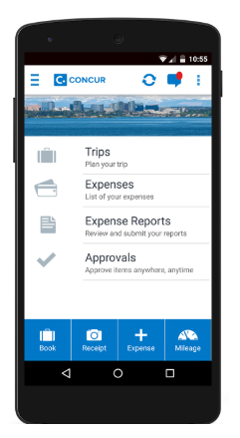
NextGen Expense Reimbursement (Concur) Introduction
What is NextGen Expense Reimbursement?
Cloud based expense management application, including electronic receipt integrations and secure mobile access
Benefits of Using NextGen Expense
Fully integrated with NextGen Finance (Projects) and NextGen Banking
Expense Tagging transactions (ERP level 4/WBS) happens automatically between Concur - Coupa
The Concur Mobile app expands accessibility to create & approve expense reports anytime/anywhere
Concur designed an updated UI for a better end user experience which was rolled out late September 2022
When to Use NextGen Expense
IEEE will reimburse for travel and non-travel related expenses such as office supplies, shipping, dues/membership, registration fees, etc.
For personal “Out of Pocket” and “IEEE Corporate Card” (if applicable) expenses
When Not to Use NextGen Expense
CB Card transactions do not get processed/entered in Concur
Local bank account activity

Slide 4
NextGen Expense (Concur) Documentation
ieee.org/expense
One stop shopping for NextGen Expense related documentation and training
How to Log in to Concur
NextGen Expense Reimbursement Checklist
View a checklist of items needed prior to creating your 1st expense report in addition to tips on submitting your report
Concur Mobile App
View a comprehensive video on how to log into the mobile application on your cellular device
Training & Quick Reference
Review self paced training or NextGen Expense Concur
View recorded training sessions from previous training events
Expense Report Purpose (ERP) Library
Frequently Asked Questions (FAQs)

Slide 5
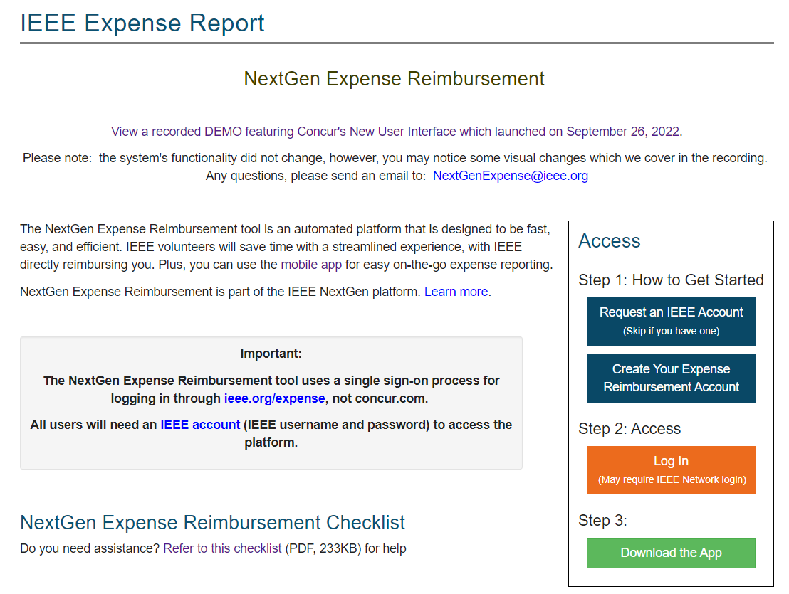
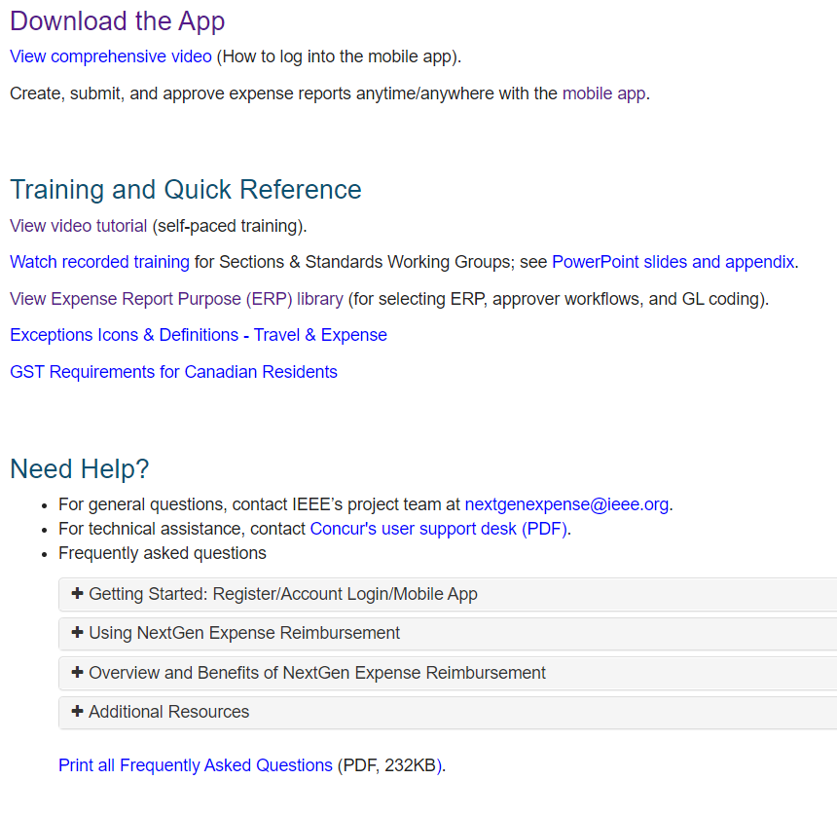
ieee.org/expense (sample screenshot)

Slide 6
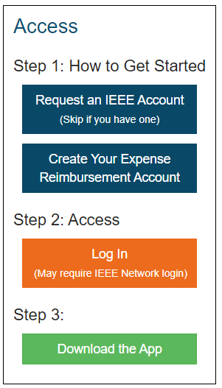
Logging into NextGen Expense is as Easy as 1-2-3
*Always access Concur with your IEEE credentials via ieee.org/expense. Never attempt to access Concur directly through concur.com*
1. Getting Started
You need an IEEE Account (IEEE username/password) -- hit blue Request button if needed
Log into your IEEE account with your IEEE username & password, then request to have a Concur account created for you.
Account creation takes approximately 24-36 hours. Once your account is created, you will receive an email with log in instructions.
2. Access Concur
Click the orange “Log In” button for direct access to Concur, a username/password are NOT required due to integration with Single Sign On (SSO)
3. Experience the benefits of the mobile app:
Submit your reports anytime, anywhere

Slide 7
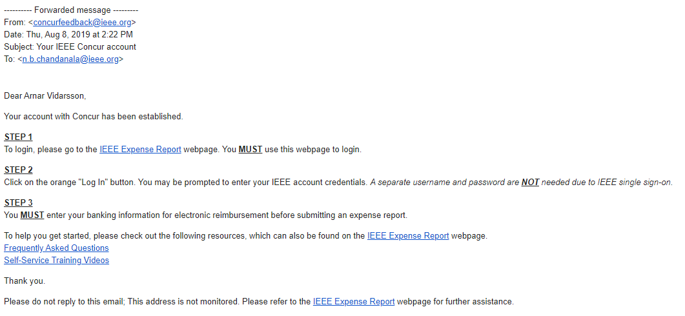
Concur Sample Enrollment Email (reimbursement in USD, CAD, EUR, INR, and JPY)

Slide 8
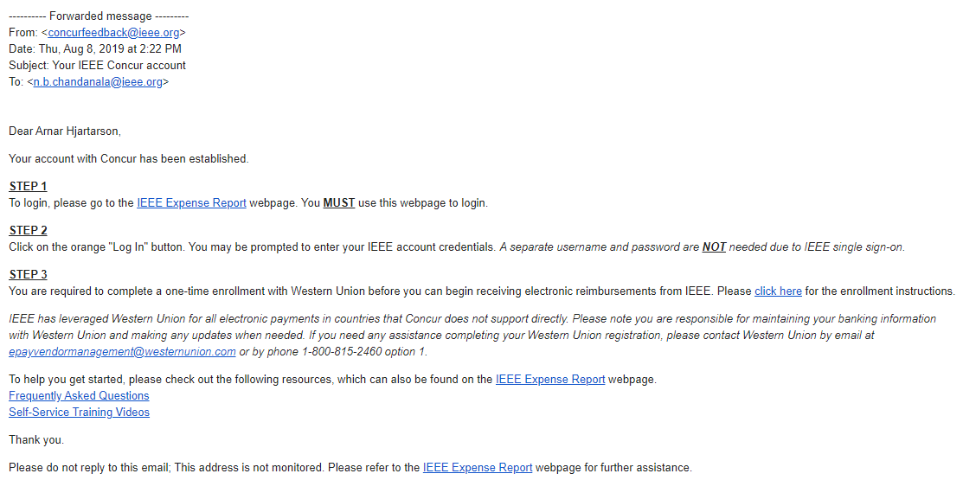
Western Union Sample Enrollment Email (all currencies except USD, CAD, EUR, INR, and JPY)

Slide 9
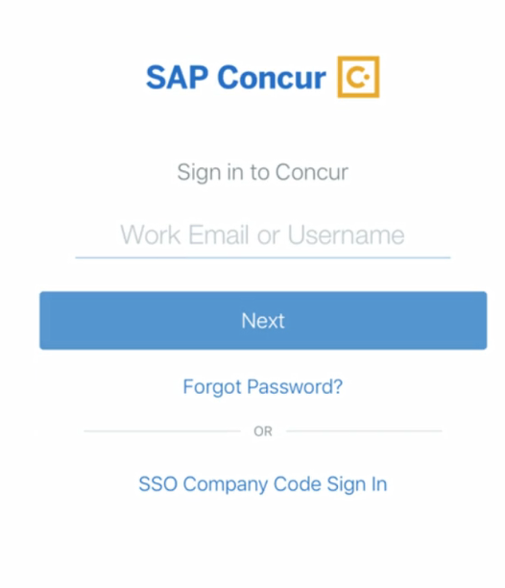
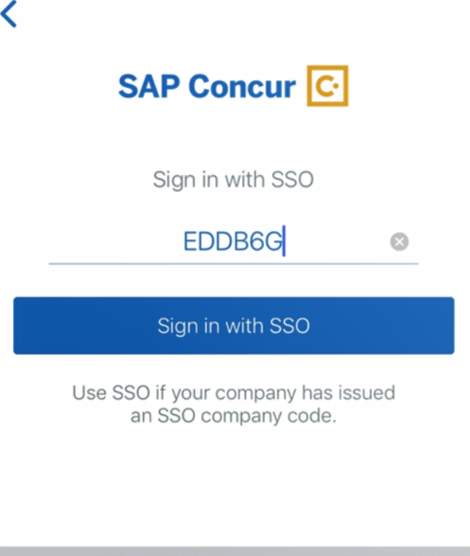
Mobile App – Access Anytime, Anywhere
Log into the mobile app securely using IEEE’s Single Sign On (SSO) passcode (EDDB6G):
Use the ExpenseIt feature to upload a receipt image directly into your Concur profile as seen below:

Slide 10
Expense Report Life Cycle
Create Expense Report
Volunteers/Members select 4-tiered Expense Report Purpose (ERP) Levels & Expense Type, which generates the:
Approvers
IEEE financial accounting and CB Account/HOP # for NextGen Banking
ERP Level 3 = Oracle PPM Project # and Project Name/Description
ERP Level 4 = Oracle PPM WBS Task # and Task Description
Expense Report Processes through “Approval Flow”
Approver(s) – Treasurer (at a minimum)
Best Practice is to have 2 Approvers per expense report purpose
To change an Approver of an ERP, please send an email to: NextGenExpense@ieee.org
The NextGen Expense team will make the system change and notify the Finance Solutions team via email
Following approvals, Concur audit and payment processing begins
Report is Processed for Payment
Payment is made electronically directly to your bank account via Concur or Western Union
Standard Concur audit, IEEE review and payment processing typically takes 3-5 business days

Slide 11
Concur & Western Union Payment Processing
Concur or Western Union (aka Convera)?
The reimbursement currency in your Concur profile is based on your Country of Residence. If you reside in a Country where the local currency is USD, EUR, CAD, JPY or INR you must enter your banking information directly into Concur.
All other currencies require the user to enroll in Western Union, this is a one-time enrollment
Additional benefit of Western Union is more flexibility to choose your bank (e.g. use your US bank even if your main country of residence is perhaps the UK)
Payment cannot be completed until banking information is provided
Western Union Contact Information:
Phone: 1-800-815-2460, option # 1
Email: Vendormanagement@convera.com
Security of Banking Information
Personal information entered in the profile is secure and can only be managed by the user
Concur and Western Union meet ISO, SSAE, and PCI Compliance standards, ensuring the utmost in security measures
Note: IEEE and Concur abide by OFAC regulations; in some cases, users may not be granted access to Concur

Slide 12
Payment Currencies Supported by Concur
EURO Countries Supported by Concur
Austria | Ireland
Belgium | Italy
Finland | Luxembourg
France | Netherlands
Germany | Portugal
Greece | Spain
in addition to USD, CAD, INR, and JPY
(otherwise, payment completed via Western Union)

Slide 13
Report Submitter Responsibilities
Complete your Concur Profile
Click Profile > Profile Settings. Personal information, verify email address, notification preferences & enter banking if required, etc.
Submit Your Expenses for Reimbursement
Submit your expenses for reimbursement within 60 days of being incurred, in accordance with the IEEE Travel & Expense Reimbursement Guidelines
Expense reports should be consolidated as much as possible
Multiple ERPs on a single report is permitted/encouraged – each transaction can utilize separate ERPs
When possible, combine various trips and submit 1 expense report per month
Delete/Remove any old expense reports in your Concur profile
*Process change for our Canadian Residents – GST will need to be manually added on each expense line starting 1/2023*

Slide 14
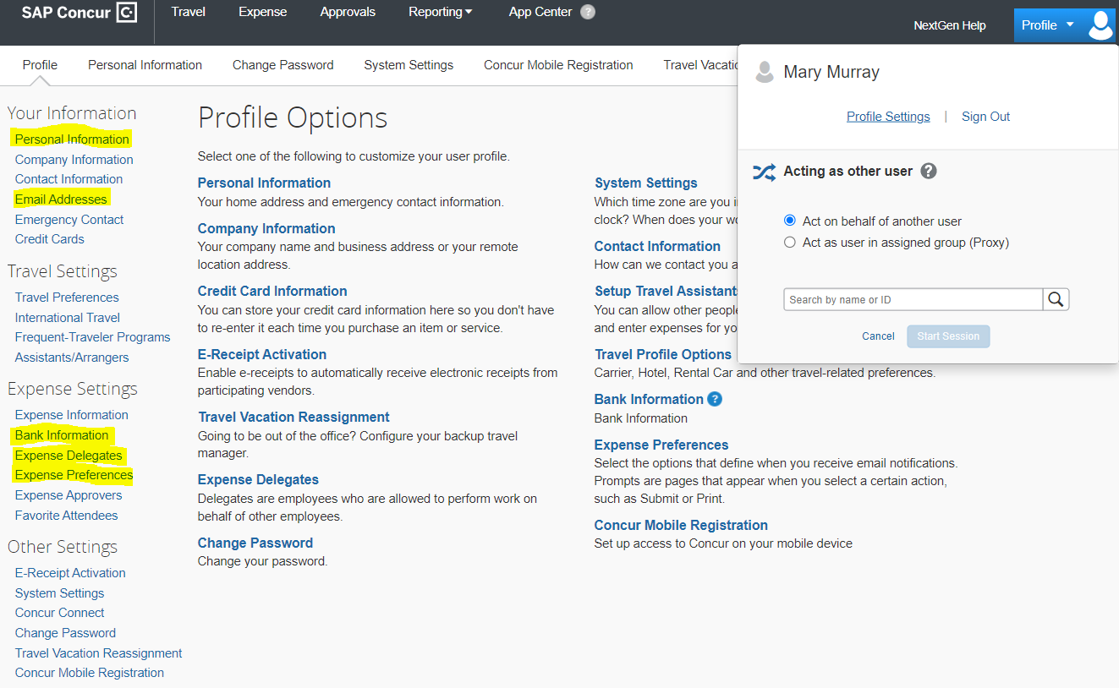
Concur “User” Profile

Slide 15
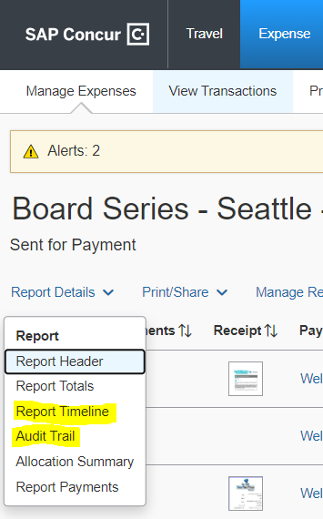
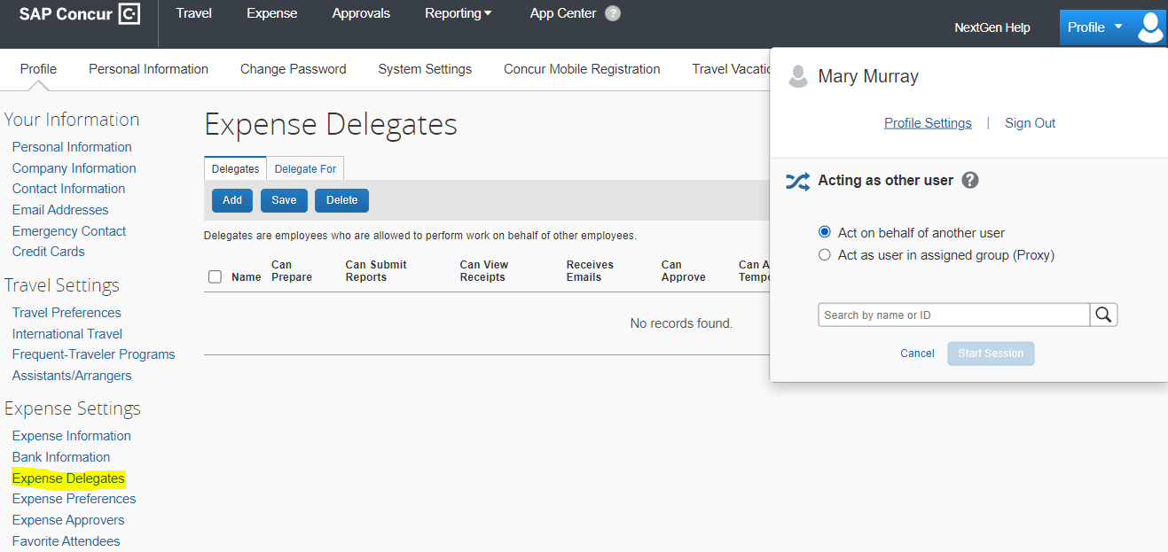
Report Submitter “Self Service” Features
View the Status of your Expense Report (Approval Flow & Audit Trail)
Real-time audit/status tracking visible to the submitter
To view the status of your expense report after it’s submitted
Report Details > Click on “Report Timeline” or “Audit Trail”
Delegate Responsibility
Users can designate a delegate to submit/approve expense reports on their behalf
A missing receipt declaration cannot be submitted by a delegate
A delegate cannot change profile information i.e., bank info, address, etc.
Receipt Options
Email receipts to: receipts@expenseit.com, they will automatically upload
into your Concur Profile (must verify email in Concur for this to work)
Integration with 3rd party applications (e.g., Uber, Lyft, etc.) which results
in electronic receipt creation

Slide 16
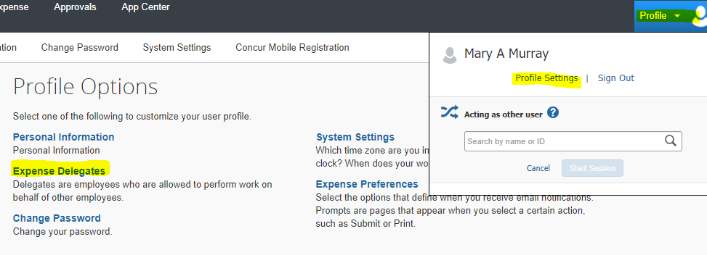
Delegates
Step 1 - How to Navigate
Profile > Profile Settings > Expense Delegates
Step 2 – How to Add Delegate
Click Add > Type in Users Name > Select the Desired Check Boxes > Save

Slide 17
Approver Responsibilities
Provide Demo & Training to all Volunteers/Users who will submit an expense report
Coordinate any training within your Region/Section, etc.
Supporting documentation/training can be found on ieee.org/expense
Become Familiar with the Expense Report Purposes (ERP’s) for your Region/Section
Maintain the approvers/approval flow of an ERP
To make changes to Approver(s) in the system, send an email to: NextGenExpense@ieee.org
ERP Level 4 (WBS Task) changes need to originate in PPM
View the expense reports that you have previously approved
Click Approvals > Reports > View – select your report criteria
Tip: if you do not see a report that you have approved listed in
report view this means the expense report has been returned to submitter

Slide 18
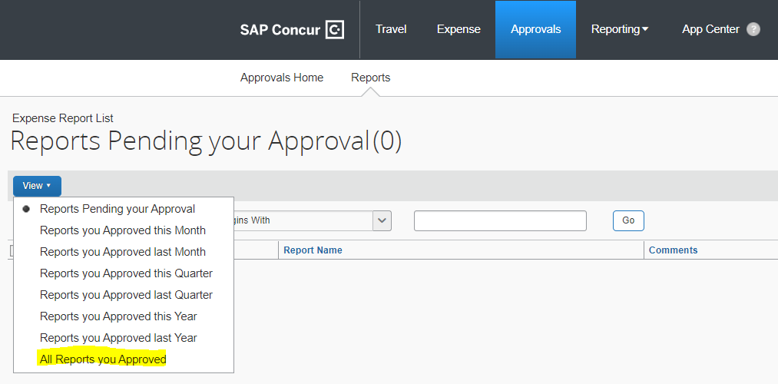
Approvers - View all Expense Reports You’ve Approved
View the expense reports that you have previously approved
Click Approvals > Reports > View – select your report criteria
Tip: if you do not see a report that you have approved listed in
report view this means the expense report has been returned to submitter

Slide 19
Always access Concur with your IEEE credentials via ieee.org/expense
For members that have access to the MNGE, you can always access Concur via the NextGen Dashboard (ieee.org/nextgen)
Self Service Featuring NextGen Help Menu
When Entering Transactions in a Foreign Currency
Use the currency shown on the receipt, Concur automatically converts the transaction to user’s local currency
If the currency conversion calculated by Concur differs from the conversion charged on your credit card, you can submit a separate expense line for Currency Exchange Fees to make your reimbursement whole
When Entering Expense Report Purposes (ERPs)
If you’re unsure which ERP to use, please contact your Region/Section Treasurer and/or your dedicated IEEE Staff Support Contact for assistance
Expenses must be recorded on the date the transaction occurred
Receipt Date = Transaction Date
Reimbursements are made in user’s local currency, per your country of residence
If your currency is incorrect in your Concur profile and you have already updated your address within your IEEE member profile, please send an email to: NextGenExpense@ieee.org

Slide 20
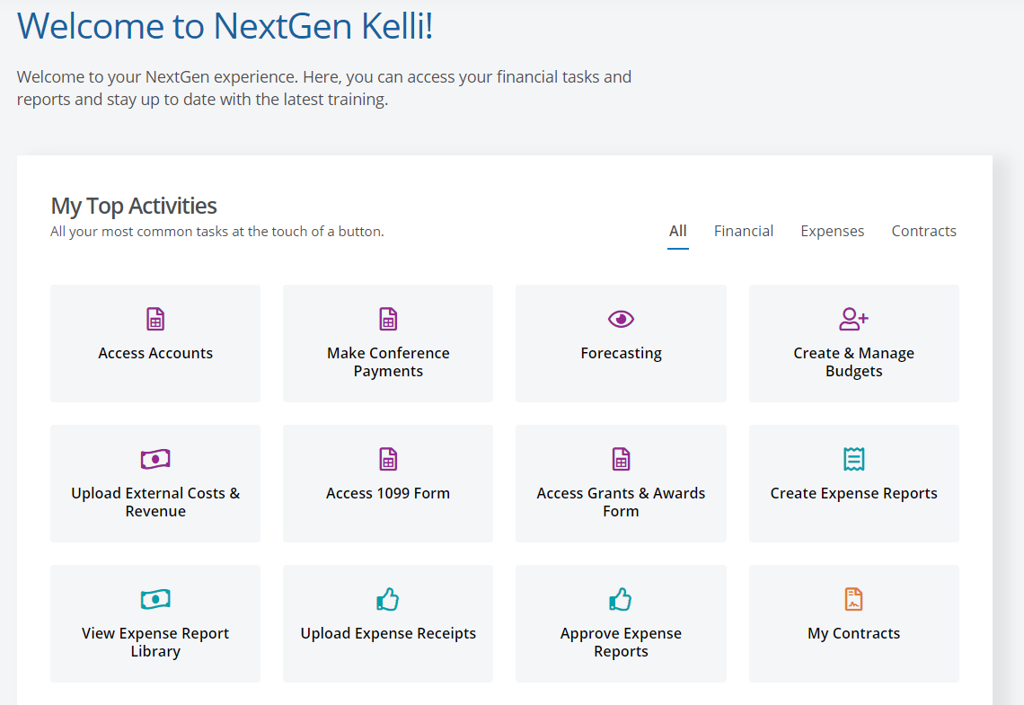
My NextGen Experience “Dashboard”
Log into NextGen Expense via the “My NextGen Experience Dashboard” or ieee.org/nextgen
User audience is limited (e.g. Treasurers and Chairs of the Geo Unit). Access is driven based on your vTools profile title.
If you are having an issue with one of the NextGen Expense buttons going through the Dashboard, please log into Concur using the instructions in the previous slide and contact the IEEE Contact Center for further assistance.
IEEE Contact Center
Email: contactcenter@ieee.org Phone: +1 800 678 4333 (USA and Canada)
Phone: +1 732 981 0060 (Worldwide)

Slide 21
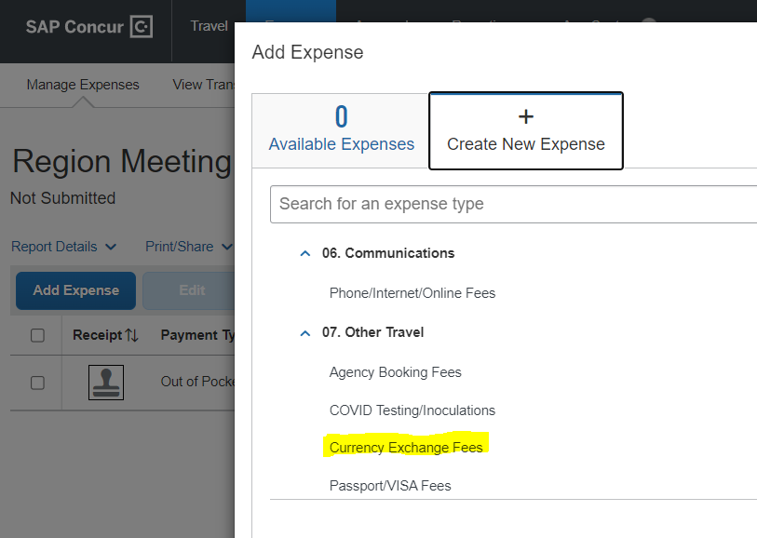
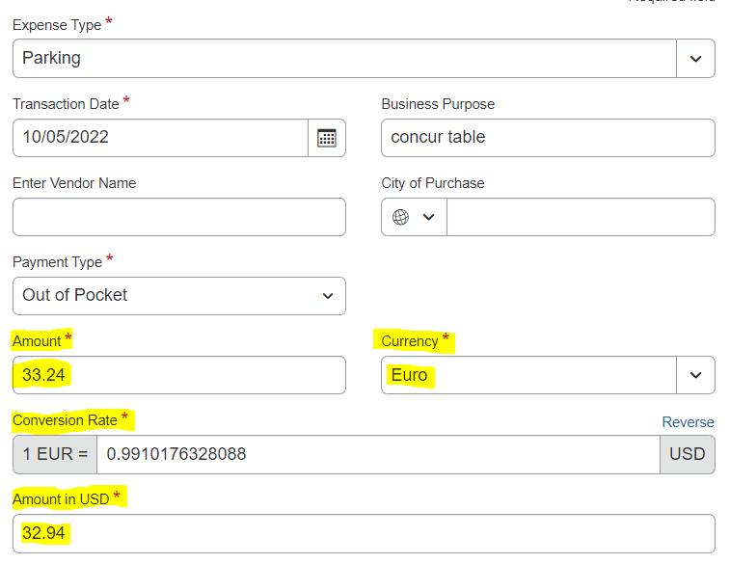
Currency Exchange Fee
Sample Expense Line
DO NOT change Conversion Rate
Expense Type
When Entering Transactions in a Foreign Currency
Use the currency shown on the receipt, Concur automatically converts the transaction to user’s local currency
If the currency conversion calculated by Concur differs from the conversion charged on your credit card, you can submit a separate expense line for Currency Exchange Fees to make your reimbursement whole

Slide 22
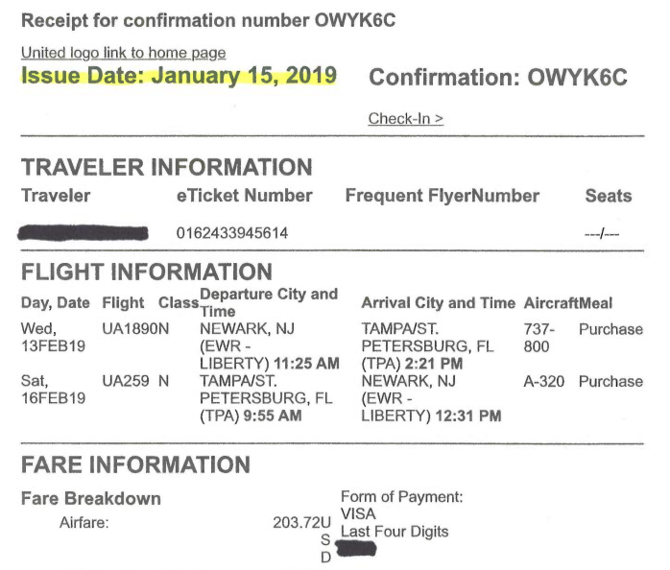
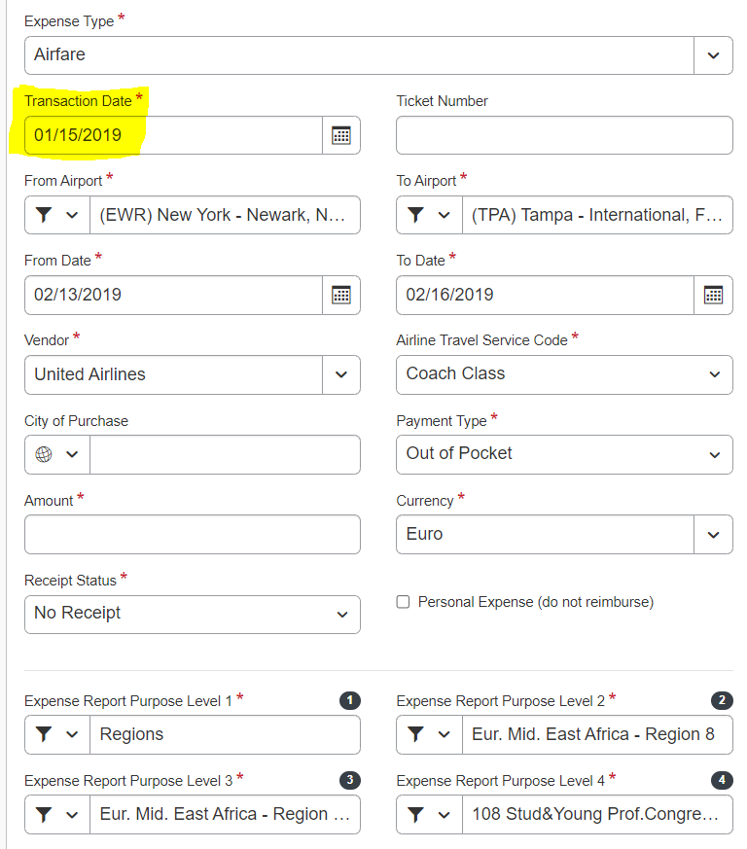
Verify Receipt Date = Transaction Date

Slide 23
NextGen Expense Reimbursement
New User Interface

Slide 24
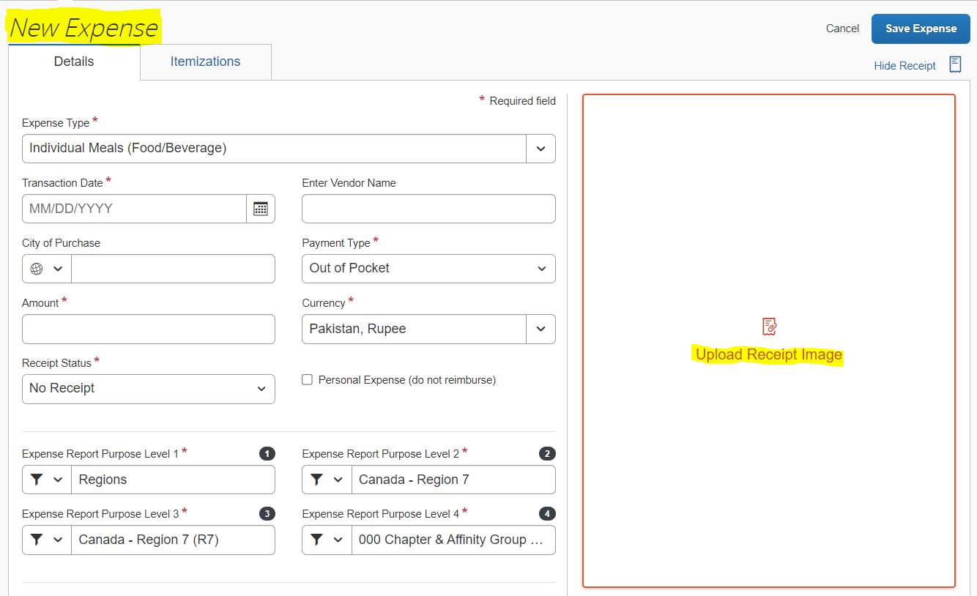
Expense Entry Line
More room to work on your expense line
Receipts are viewable while entering your expense

Slide 25
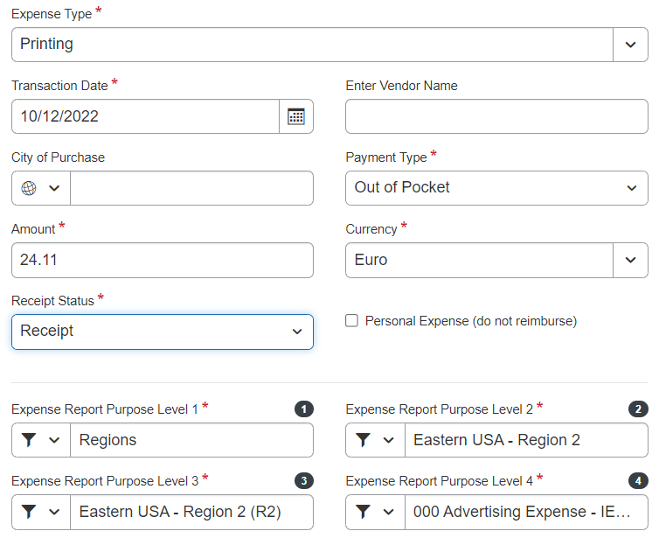
Tiered Expense Report Purpose (ERP) Levels
Report Header
Expense Line Entry
ERP 3 = Oracle
PPM Project
ERP 4 = Oracle
PPM Task/WBS
Appendix D

Slide 26
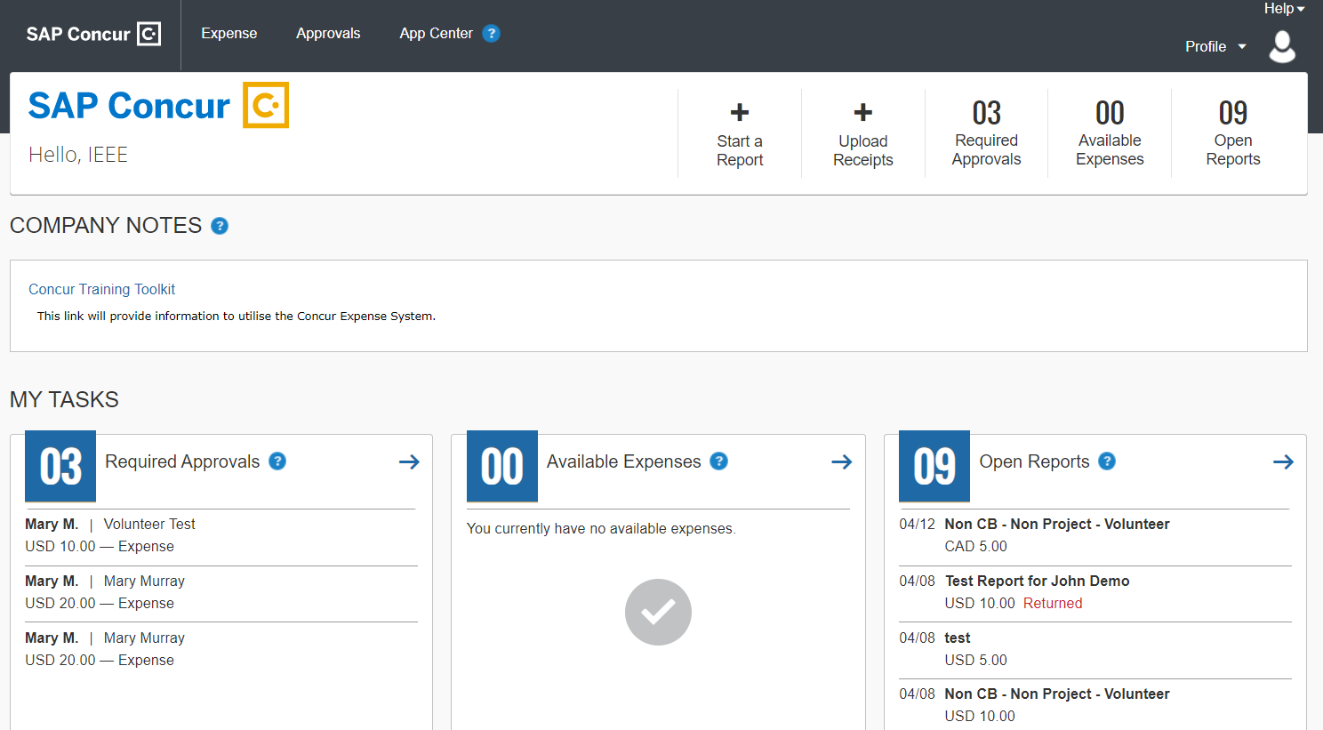
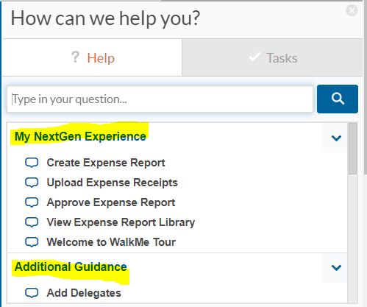
Self Service Featuring “NextGen Help Menu”
Click on Menu to Expand
Expanded Menu (3 Sections)
Assistance from NextGen Help (WalkMe)
Walkthroughs (step-by-step guided learning)
Smart Tips (helpful hints)

Slide 27
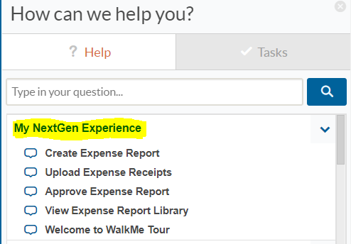
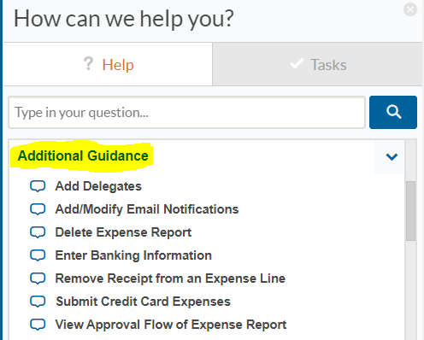
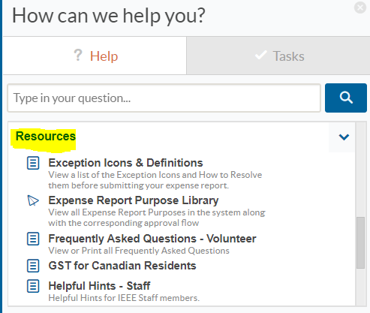
NextGen Help “Help Menu”
NextGen Help – Help Menu
Consists of 3 Sections:
My NextGen Experience
Additional Guidance
Click on items listed to experience step-by-step guided learning
Resources
Click on items for additional documentation/information

Slide 28
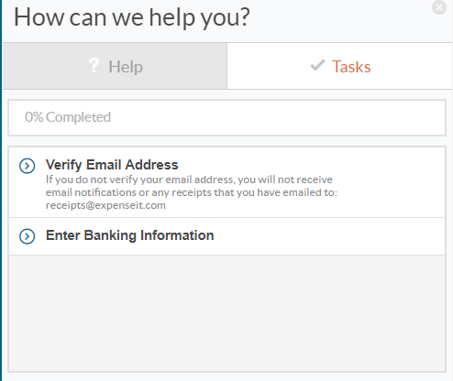
NextGen Help “Tasks Menu”
NextGen Help – Tasks Menu
Suggested tasks to complete before using Concur
Verify Email Address
Needed for:
Email Notifications
Using receipts@expenseit.com
Enter Banking Information
Concur requirement if you are receiving your reimbursements via Concur

Slide 29
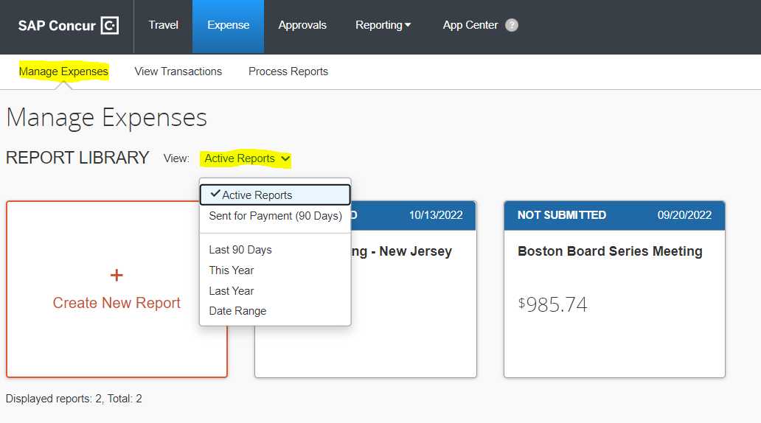
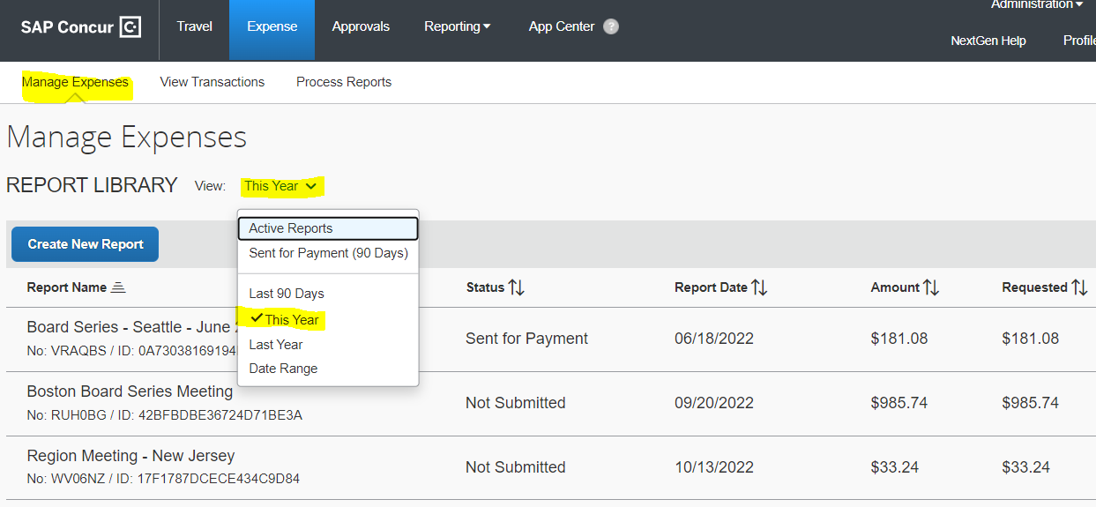
Report Library
View your “Active Reports” for current status
View your report history by changing the view to: This Year, Last Year, etc.

Slide 30
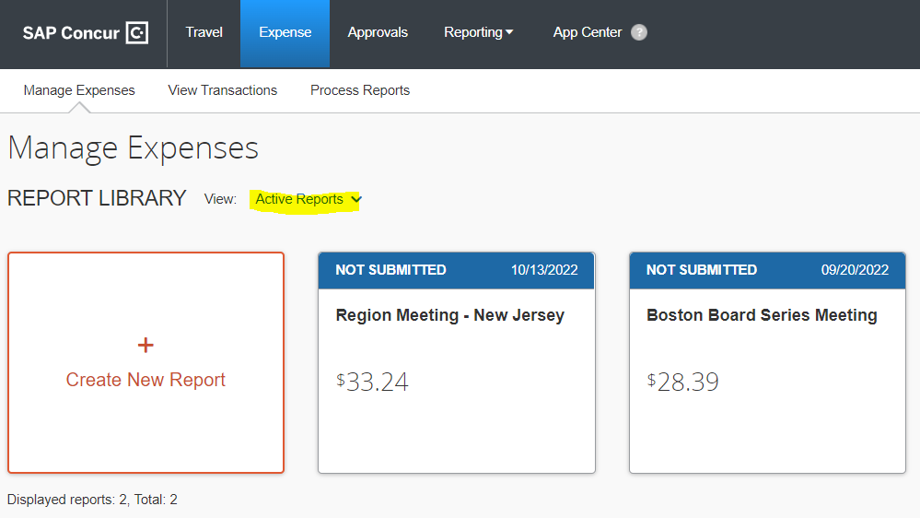
“What’s the Status of my Expense Report?” Approval Flow/Report Timeline
Step 1 – Click on “Expense”
Step 2 – Change the “View” in Report Library
*Please note: You can only see the approval flow/report timeline after the report has been submitted*

Slide 31
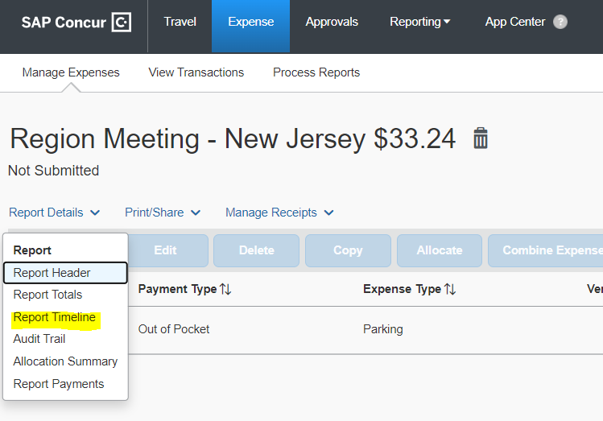
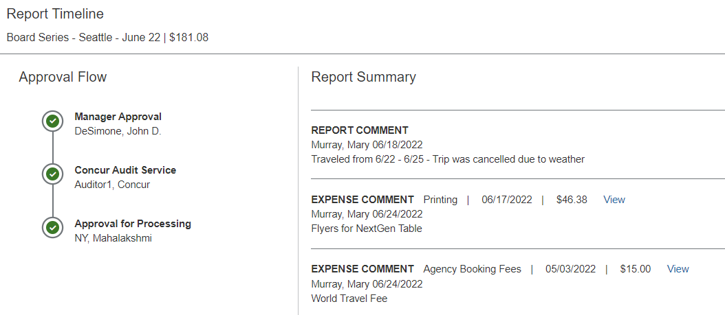
“What’s the Status of my Expense Report?” (cont.) Approval Flow/Report Timeline
Step 3: Open Report, click on Report Timeline
Step 4: Review Report Timeline to see Status
*Please note: You can only see the approval flow/report timeline after the report has been submitted*

Slide 32
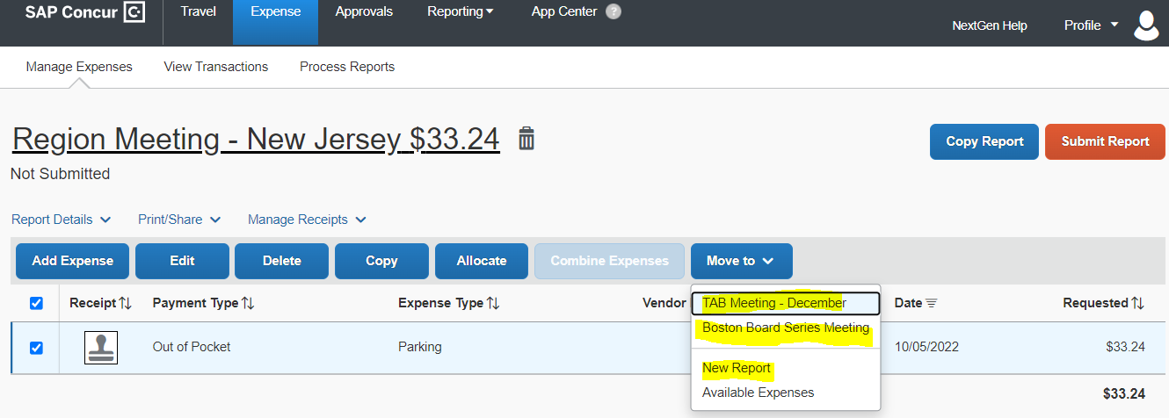
Combine Expense Reports using MOVE command
How to “Move” an expense line to another expense report
Please check the expense line(s) that you would like to move
Click the blue “Move to” box
Select the report that you would like to move the expense(s) to: New Report, TAB Meeting – December or Boston Board Series Meeting

Slide 33
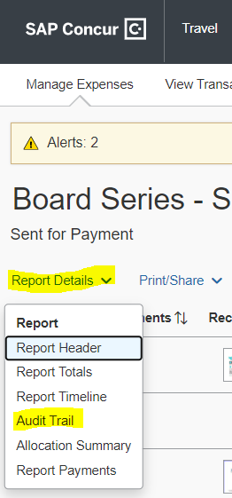
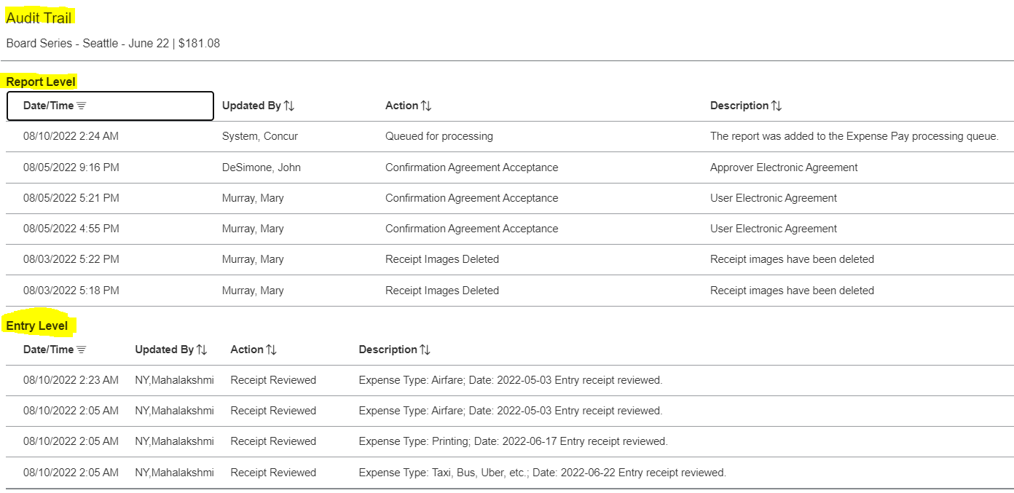
Audit Trail
Step 1 - How to Navigate
Step 2 – Click on Audit Trail
*Please note: You can only see the audit trail after the report has been submitted*

Slide 34
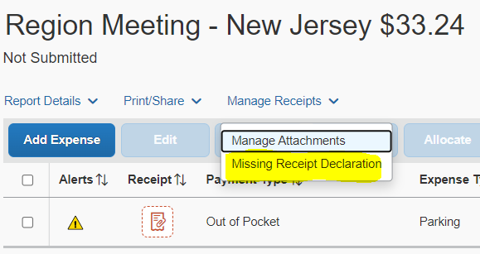
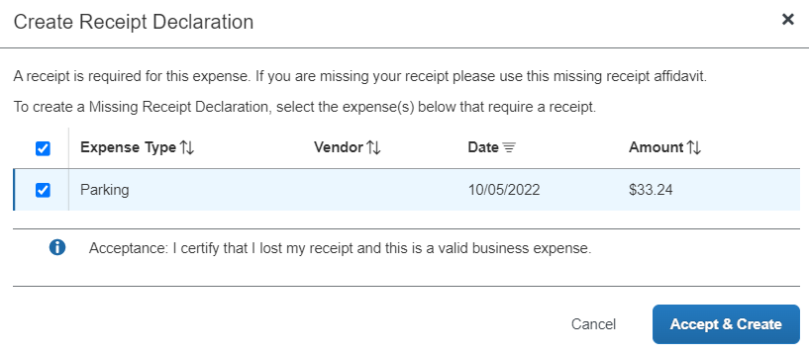
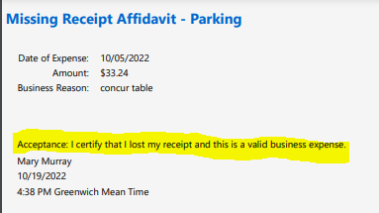
Missing Receipt Declaration
Step 1 - How to Navigate
Step 2 - Select Transaction
Step 3 - Final Confirmation

Slide 35
Contact Information
Please send all questions, comments, feedback and suggestions to: NextGenExpense@ieee.org
(formally known as: concurfeedback@ieee.org)

